Slide 1

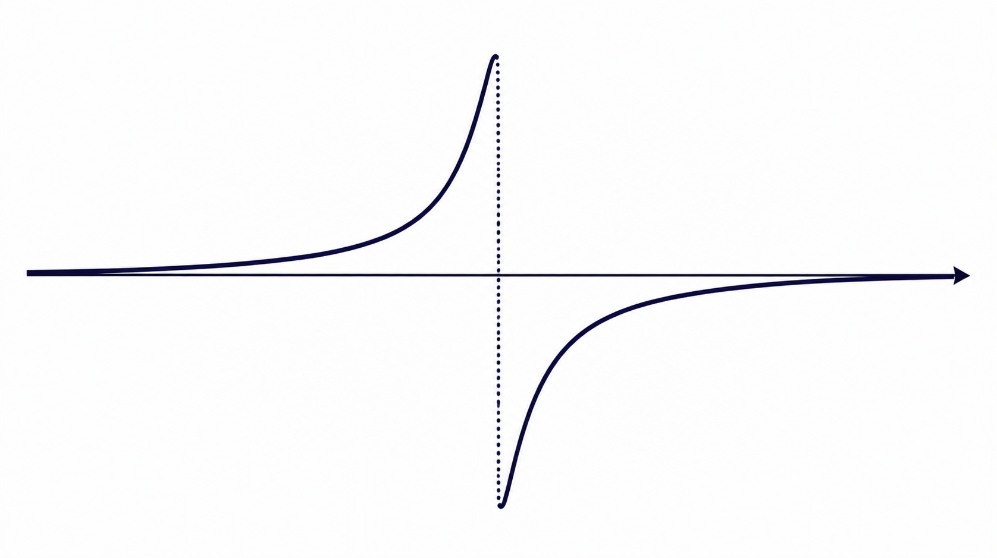


Amplitude-Robust Qubit Spectroscopy Using Echo-Root-Lorentzian Pulse Shapes
Asaf Solonnikov | Nadav Katz

Slide 2

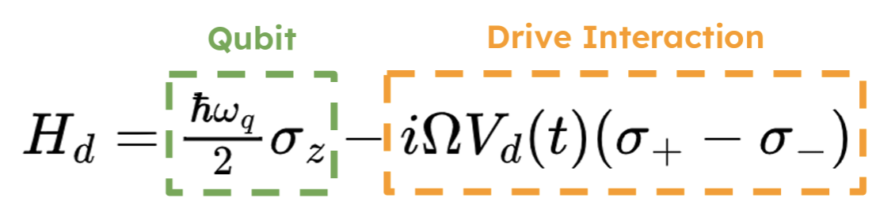
Superconducting qubits
Title

Slide 3
Power broadening
Title

Slide 4
Frequency calibration needs resolution without fragile low-amplitude scans
Title

Slide 5
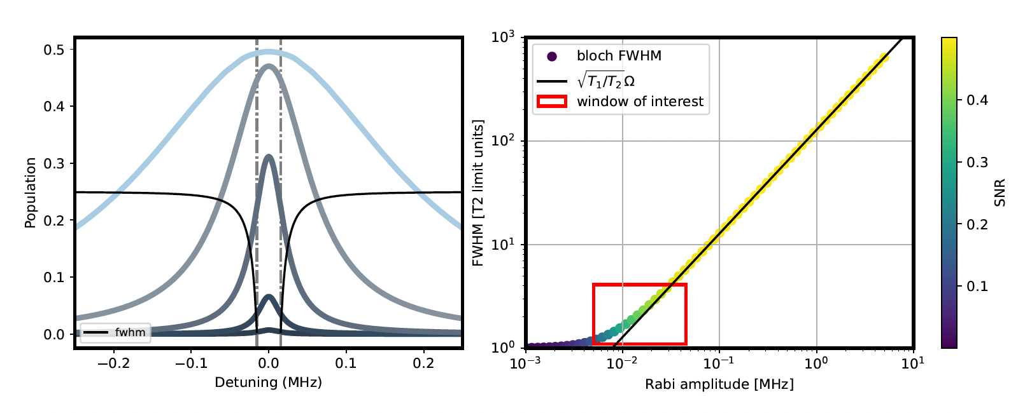
Frequency calibration needs resolution without fragile low-amplitude scans
Title

Slide 6
A root-Lorentzian envelope plus π-phase inversion creates an echo-like spectroscopy pulse
Drive envelope
Adiabatic shaping
π inversion
Echo dip
L⁽ⁿ⁾(t) = 1 / [1 + (t/τ)²]ⁿ
The pulse changes phase at peak amplitude.
Resonant excitation cancels; detuned response remains.
Lorentzian-derived pulse narrows the response.
Lᵉᶜʰᵒ₁/₂(t) := L₁/₂(t) · sgn(t)
τ sets duration; n controls sharpness; the sign change gives echo-like symmetry.
Mechanism: suppress on-resonant Rabi oscillations while preserving a sharp spectral feature for frequency extraction.
Title

Slide 7
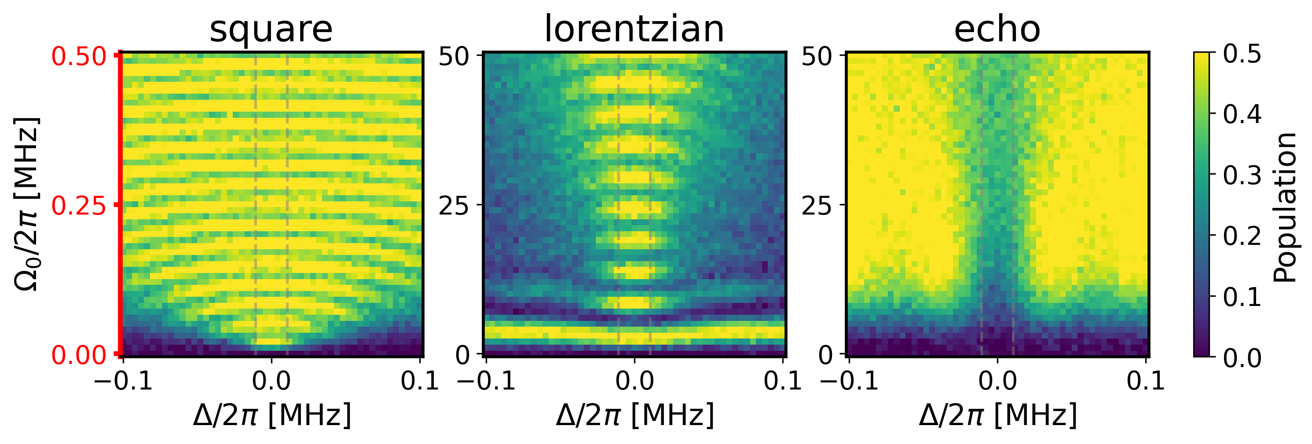
Three order of magnitude robustness
Suppresses coherent oscillations
Amplitude robustness
Title

Slide 8
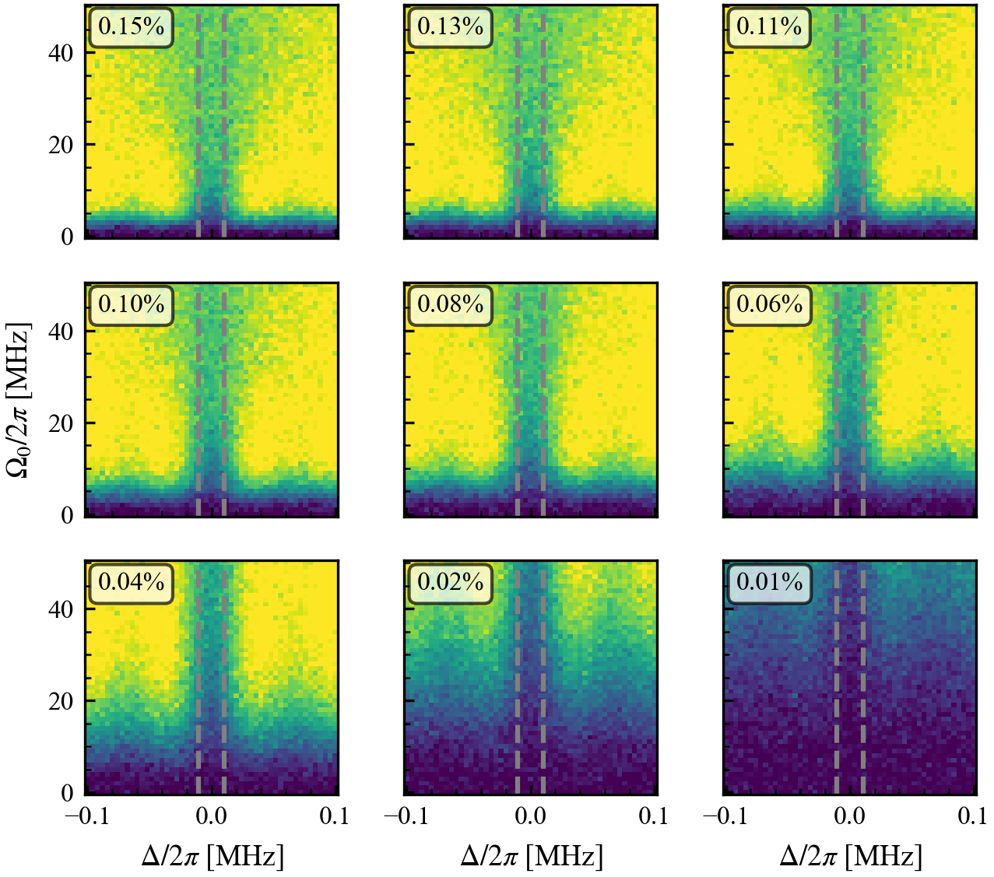
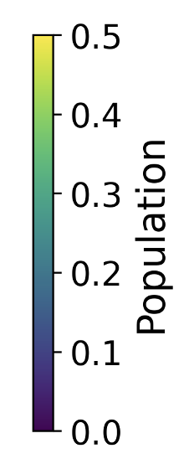

Slide 9
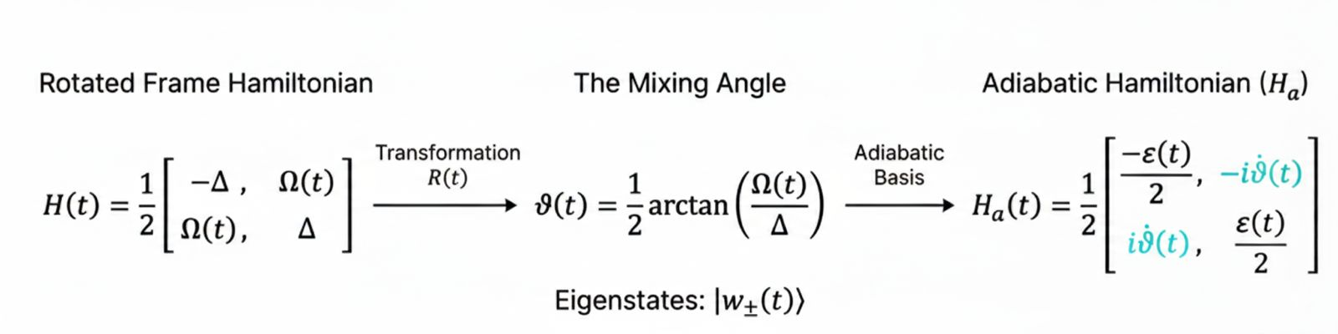
Adiabatic basis: power narrowing
Title

Slide 10
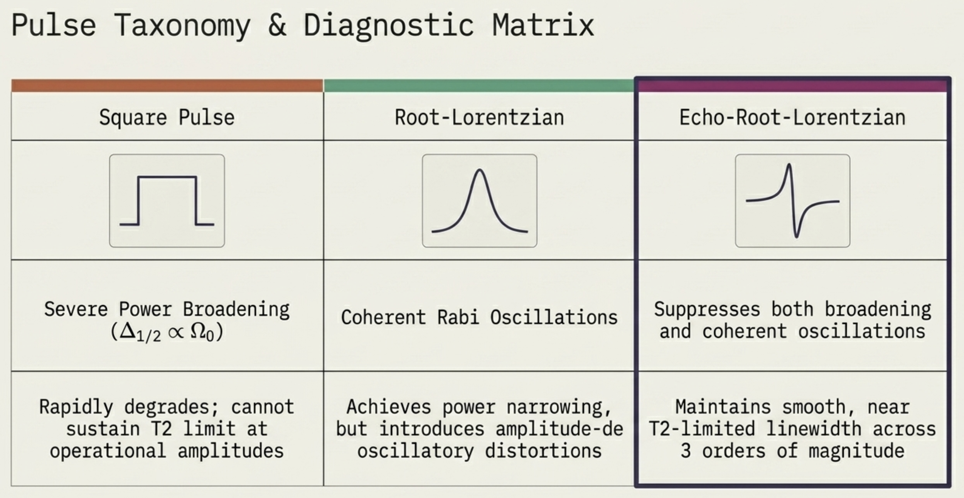
Adiabatic basis: power narrowing
Title

Slide 11
System: superconducing qubits
Title

